Slide 1
Training & Testing
First steps in ML using scikit-learn
ACM at UGA

Slide 2
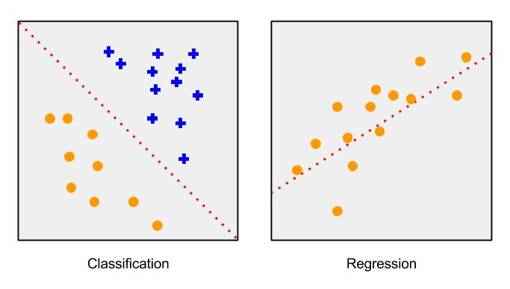
Quick Review:
We visualize our dataset as a 2d array. The rows are instances (examples) and the columns are features (attributes). For a Supervised Learning task, we have a target feature, or label for each instance.
2 main types of Supervised Learning problems:
Classification - Our instances belong to one of several classes, and we want to learn from already labeled data how to predict the class of unlabeled data
Regression - the desired output consists of one or more continuous variables

Slide 3
Train/Test Split
We need to set aside part of our data set, so we can evaluate our model after training. Remember, we’re not trying to simply memorize the training data - we want a model that can handle instances it has never seen.
We want our model to generalize well.
We partition the dataset into a Training Set and a Testing Set.
It is very important that we see as little of the test set as possible to prevent bias on our end.
This is called Data Snooping Bias. The human brain is extraordinary at detecting subtle patterns. If you examine the test set too closely, you risk overfitting the test set, and having an unrealistically high accuracy, which won’t be reflected when you start processing real world data
We also separate the target column from the non-target features. This leaves us with four objects. data_train, target_train, data_test, and target_test.
What do these four objects look like?

Slide 4
Scikit-learn http://scikit-learn.org/stable/
ML library in python that builds on other python libraries (Numpy, pandas, etc)
Provides numerous estimators (models) for a variety of ML problems
Each estimator provides two important methods:
fit(): trains the model on our data. We need to pass in the training data, as well as the training labels
predict(): returns a predicted class or target value. We pass in one or more instances
Scikit-learn also provides…
Several small (‘toy’) datasets for easy & quick experimentation with different kinds of problems.
Classes and methods for preprocessing data
Tools for evaluating and comparing different models, and for tuning a particular model
Data visualization tools.

